Slide 1
Process Management
Unix/Linux Commands

Slide 2
Topics
Shell Commands
ps
kill
Unix/Linux System Calls in C/C++
getpid ()
getppid()
system()
fork ()
exec() / execv() / execl() / execve() / execvp() / execlp()
spawn()
wait() / waitpid()
kill()

Slide 3
Process Creation
Once the OS decides to create a new process it:
Assigns a unique process identifier
Allocates space for the process
Initializes process control block
Sets up appropriate linkages
Creates or expand other data structures

Slide 4
System Call: Executing a command
int system (const char *command)
This function executes command as a shell command

Slide 5
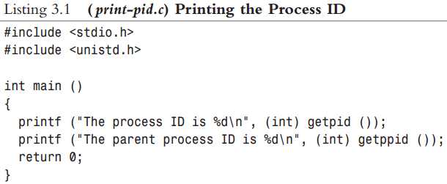
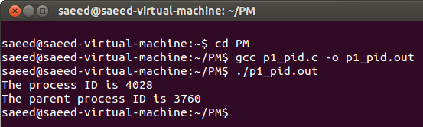
Sample Code : getpid() , getppid()

Slide 6
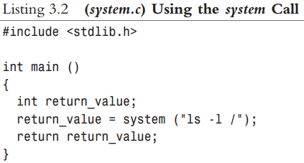
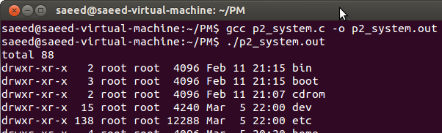
Sample Code : system()

Slide 7
System Call: Creating a Process
pid_t fork (void) / pid_t vfork (void)
fork() makes a complete copy of the calling process's address space and allows both the parent and child to execute independently
vfork() does not make copy. Instead, the child process created with vfork shares its parent's address space until it calls _exit or one of the exec functions. In the meantime, the parent process suspends execution.
fork() | vfork()
Separate Address Space / 2 images | Shared address space / 1 image
Both parent & child run | Parent suspended

Slide 8
Process Creation
Process creation is by means of the kernel system call,fork( ).
This causes the OS, in Kernel Mode, to:
Allocate a slot in the process table for the new process.
Assign a unique process ID to the child process.
Copy of process image of the parent, with the exception of any shared memory.

Slide 9
Process Creation
Increment the counters for any files owned by the parent, to reflect that an additional process now also owns those files.
Assign the child process to the Ready to Run state.
Returns the ID number of the child to the parent process, and a 0 value to the child process.

Slide 10
After Creation
After creating the process the Kernel can do one of the following, as part of the dispatcher routine:
Stay in the parent process.
Transfer control to the child process
Transfer control to another process.
Notes:
When the kernel has completed these functions it can do one of the following, as part of
the dispatcher routine:
• Stay in the parent process. Control returns to user mode at the point of the fork call of the parent.
• Transfer control to the child process. The child process begins executing at the same point in the code as the parent, namely at the return from the fork call.
• Transfer control to another process. Both parent and child are left in the Ready to Run state.

Slide 11
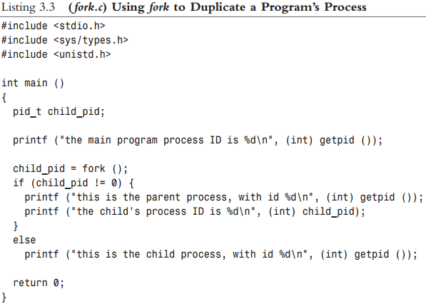
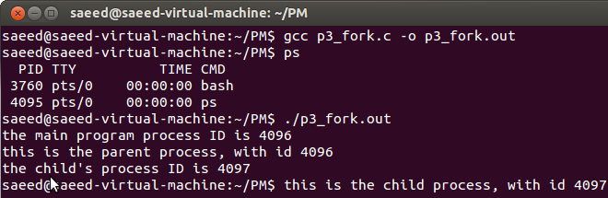
Sample Code : fork()

Slide 12
System Call: Executing a file
executes the file named by filename as a new process image.
int execv (const char *filename, char *const argv[])
int execvp (const char *filename, char *const argv[])
int execve (const char *filename, char *const argv[], char *const env[])
int execl (const char *filename, const char *arg0, ...)
int execlp (const char *filename, const char *arg0, ...)

Slide 13
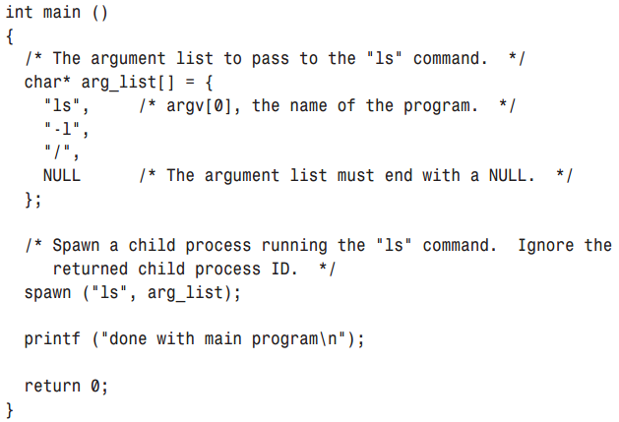
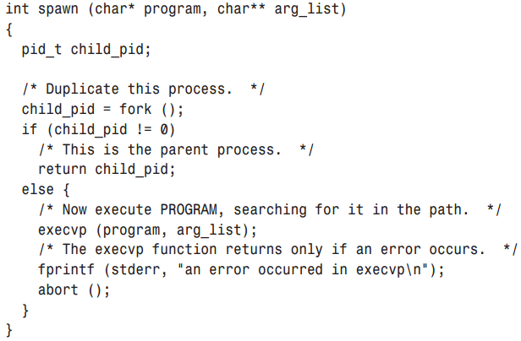
Sample Code : fork() , exec() . Listing:3.4

Slide 14
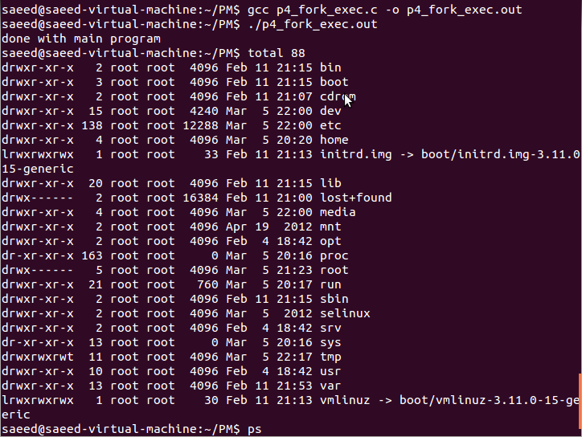
Output : fork() , exec() . Listing:3.4

Slide 15
System Call Waiting for a process completion
pid_t waitpid (pid_t pid, int *status-ptr, int options)
pid_t wait (int *status-ptr)
calling process is suspended until the child process makes status information available by terminating.

Slide 16
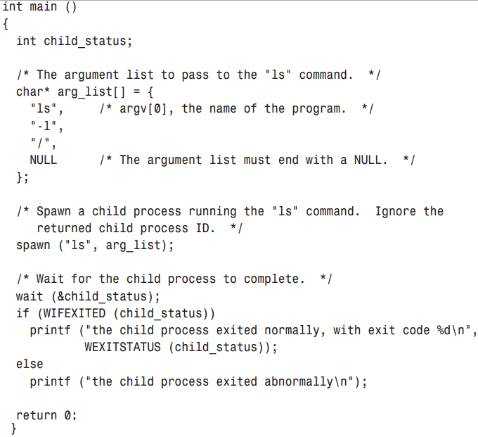
Sample Code : wait()

Slide 17
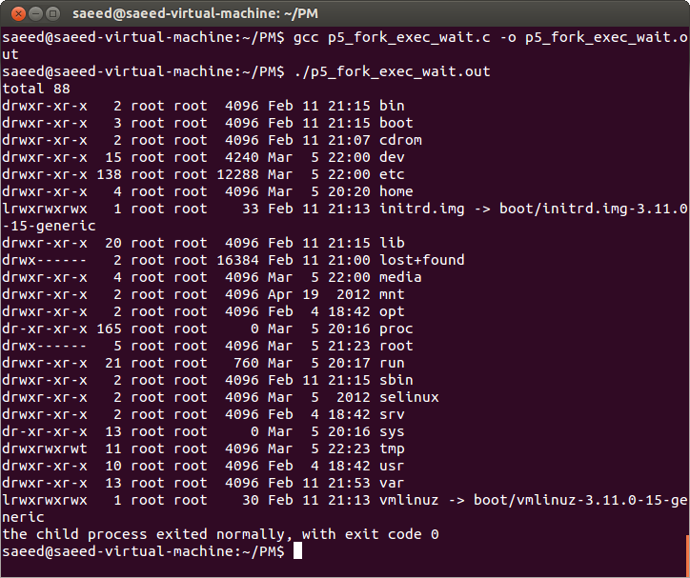
Sample Code : wait()

Slide 18
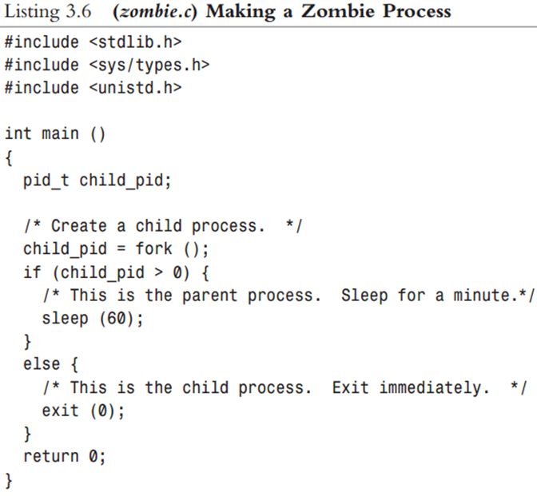
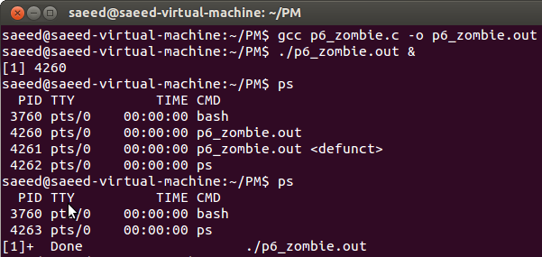
Sample Code : zombie process

Slide 19
reference
http://www.advancedlinuxprogramming.com/alp-folder/alp-ch03-processes.pdf

